Slide 1
Problem Statement - 3
Unilever Data Science POC Use Case
Theme:Deep Tech/Machine Learning
Team: Bizzaro
Members:
1). Kunal Dang
2).Hussain Bohra
3). Keshav Kumar
4). Aditya Jain

Slide 2
Problem Definition
One of Uniliver brands is going through some major changes in business execution plans and will like to know.
i. What are the major drivers for sales(EQ)?
ii. Knowing the drivers, how accurately we can predict future sales for next 6 periods?

Slide 3
Technology used
R programming language
Python
R Packages: bnlearn, dplyr
Python Packages: Numpy, Pandas, Statsmodel, Scipy
Azure Machine Learning
Azure Notebooks

Slide 4
Major Drivers of Sales(EQ)
To find the major drivers of sales we will use Bayesain Network Structure Learning Algorithm: Max-Min Hill-Climbing (MMHC)
The Bayesian network is one of the effective tools for study of knowledge representation and causal reasoning in the conditions of uncertain in the field of Artificial Intelligence. How to construct a Bayesian network structure from data have become a hot point in recent study. Max-Min Hill-Climbing (MMHC) algorithm is a newly Bayesian network structure learning algorithm.
To learn more about this algorithm: https://download.atlantis-press.com/article/25907289.pdf

Slide 5
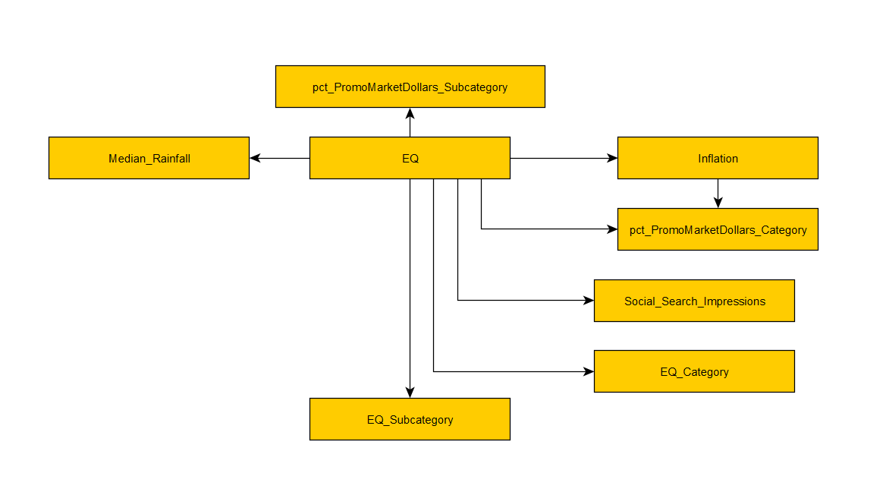
Bayesian Network results

Slide 6
Bayesian Network results
We got to know that there are 7 major drivers of Sales:
Social Search Impressions
Inflation
Median Rainfall
Pct Promo Market Dollars Category
Pct Promo Market Dollars Subcategory
EQ Category
EQ Subcategory

Slide 7
Forecasting with VAR
Vector Autoregression (VAR) is a forecasting algorithm that can be used when two or more time series influence each other. That is, the relationship between the time series involved is bi-directional.
To check the Stationarity we used Augmented Dickey Fuller Test and Got to know that the series are non stationary.

Slide 8
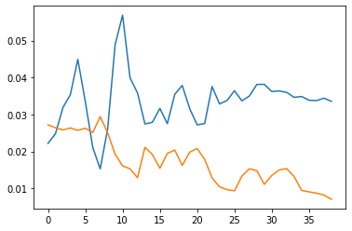
Results
Legend
blue-> Prediction
red-> Actuals
X axis-> time period
Y axix-> scaled EQ value
To select the right order of VAR model, We’ve iteratively use increased Lag values and tried to find the lag which gives the Least AIC value which in this case was 32.

Slide 9
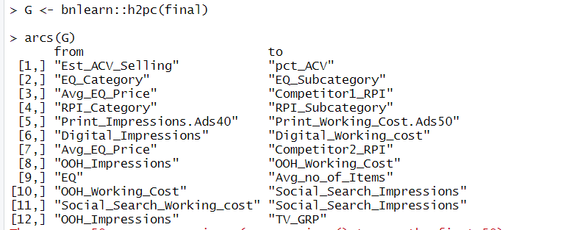
2nd Hurdle - Key Indicators of Sales
For Bayesain Network of new dataset, We used H2PC Algorithm(As mmhc didn’t give good results) for structure learning, And it gave the results as following.

Slide 10
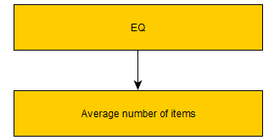
2nd Hurdle - Key Indicators of Sales
According to H2PC algorithm the only key indicator of Sales is:
Average number of items
So we will use this in our VAR model

Slide 11
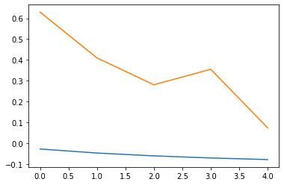
Results
Legend
blue-> Prediction
red-> Actuals
X axis-> time period
Y axix-> scaled EQ value
To select the right order of VAR model, We’ve iteratively use increasing Lag values tried to find the lag which gives the Least AIC value which in this case was 1..

Slide 12
AIC values
VAR Order Selection (* highlights the minimums)
AIC BIC FPE HQIC
0 -5.847 -5.750 0.002889 -5.819
1 -7.444* -7.154* 0.0005861* -7.361*
2 -7.425 -6.941 0.0006021 -7.286
3 -7.209 -6.532 0.0007601 -7.014
4 -7.092 -6.221 0.0008830 -6.841
5 -6.963 -5.898 0.001060 -6.656
6 -6.747 -5.489 0.001430 -6.385
7 -6.554 -5.102 0.001969 -6.136
8 -6.852 -5.207 0.001766 -6.378

